Slide 1
DDS Debugging
AD9910 Verilog & Board Debug

Slide 2
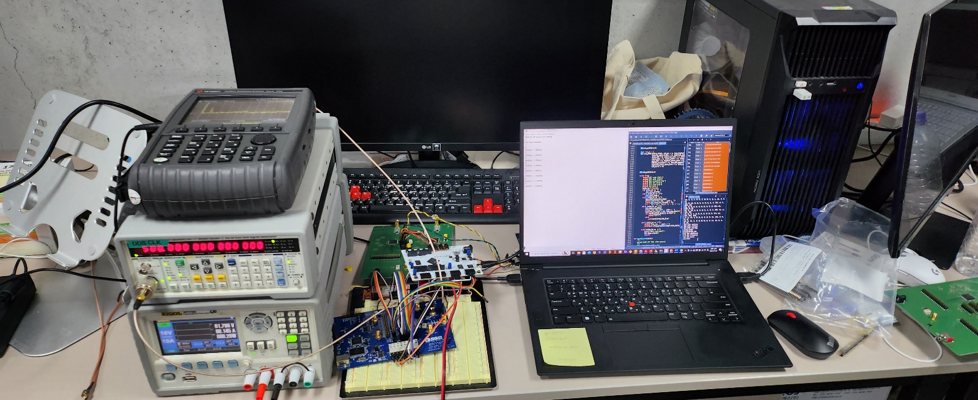
Test with Analog Device evaluation board
Profile | Input Frequency | Output Frequency
0 | 100MHz | 50MHz
1 | 120MHz | 60MHz
2 | 140MHz | 70MHz
3 | 160MHz | 80MHz
4 | 180MHz | 90MHz
5 | 200MHz | 100MHz
6 | 220MHz | 110MHz
7 | 240MHz | 120MHz
With IO update signal, there was no glitch problem

Slide 3
To Fix Noise Problem
Insert attenuator, amplifier
Anlog signal -> high Q
Digital signal -> low Q
Clock length should be more shortened! (long trace -> high L -> high interference)
Digital power, analog ground segmented? -> if not, should be done
Decoupling capacitor should be placed

Slide 4
Pin
VCC | GND | ja_3 SCLK | ja_2 IOUP2 | ja_1 SDIO2 | ja_0 CSB2
VCC | GND | ja_7 IOUP1 | ja_6 SDIO1 | ja_5 CSB1 | ja_4 PO[18]
GND | PROF1[2] jb_7
GND | PROF1[1] jb_6
GND | PROF1[0] jb_5
GND | IO_UPDATE1 ja_7
GND | IO_UPDATE2
GND | PROF2[0]
GND | PROF2[1]
GND | PROF2[2]
GND | RESET1
GND | SDIO1 ja_6
GND | SCLK1 ja_3
GND | CSB1 ja_5
GND | CSB2
GND | SCLK2
GND | SDIO2
GND | RESET2
VCC | GND | jb_3 P2[1] | jb_2 P2[0] | jb_1 PO[17] | jb_0 PO[16]
VCC | GND | jb_7 P1[2] | jb_6 P1[1] | jb_5 P1[0] | jb_4 P2[2]

Slide 5
PCB Problem
1. Clock RF circuit does not work properly!
-> impedance due to via, resitor position is not proper
-> S parameter : Spectrum Analyzer, SI : Loop Probe
2. Clock trace and output trace is too close
-> feed through problem occurs
3. Filter can be replaced to IC
4. Digital, analog ground should be separated
5. Decoupling capacitor should be placed to pin more closely
-> Farther decoupling capacitance, more high parasitic inductance.

Slide 6
Clock Problem

Slide 7
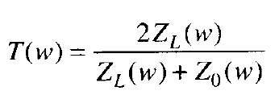
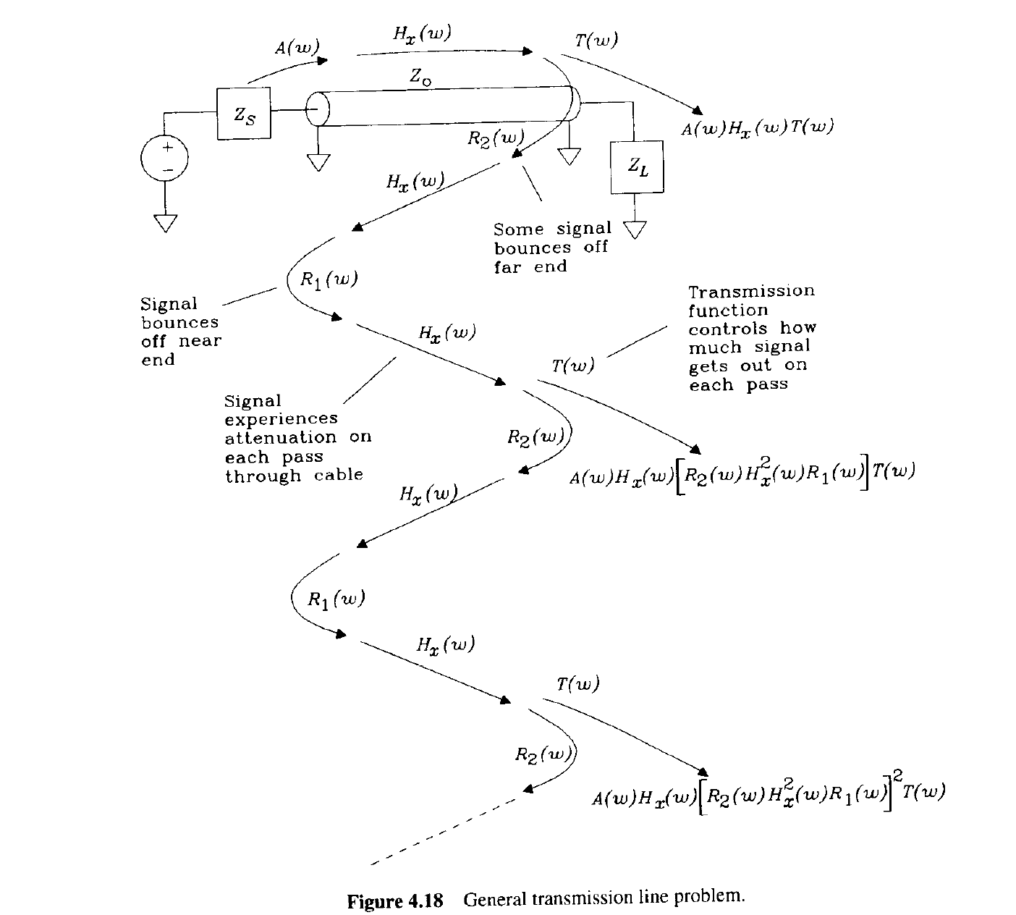
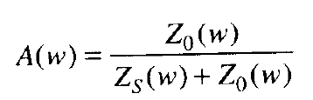
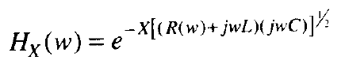
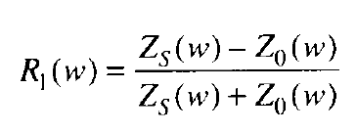
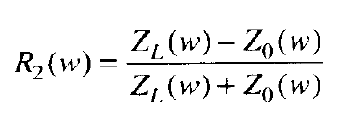
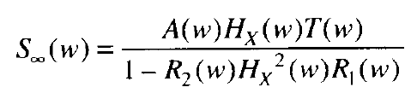
Reflection

Slide 8
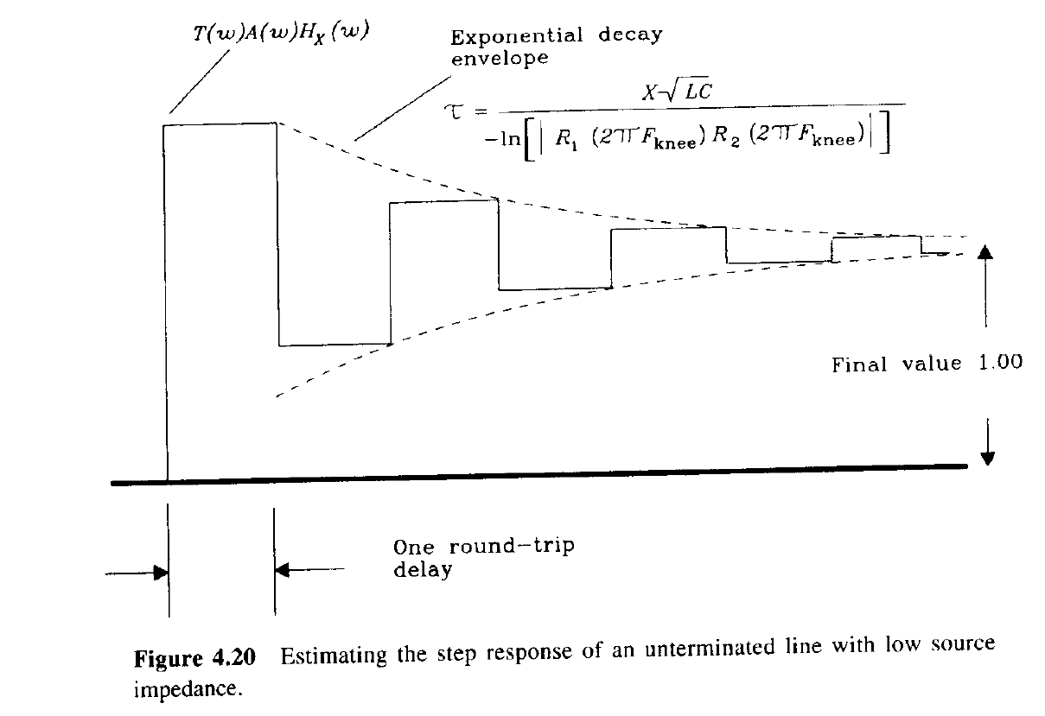
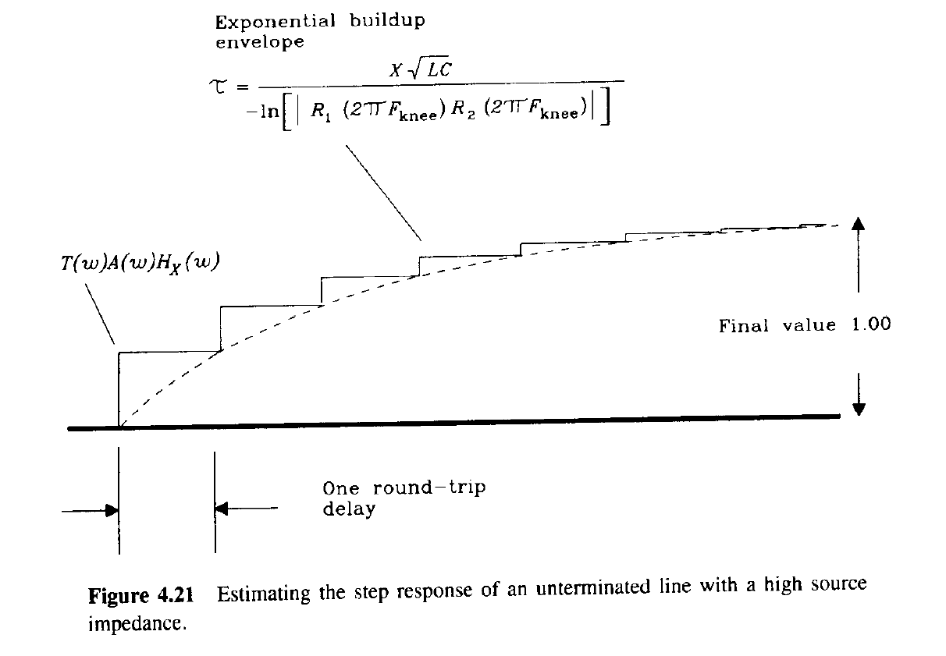
Reflection

Slide 9
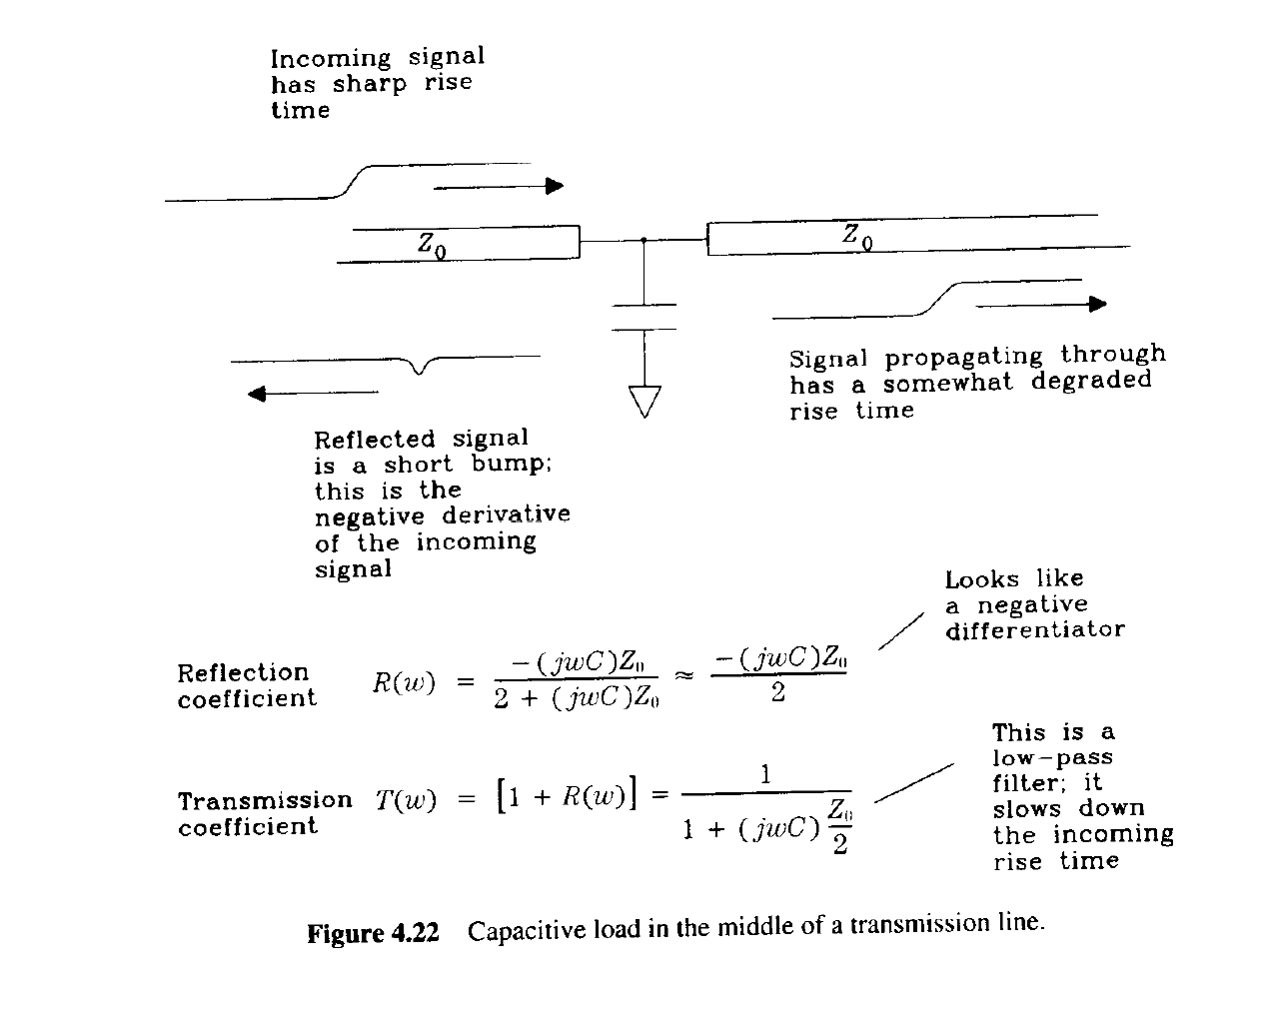
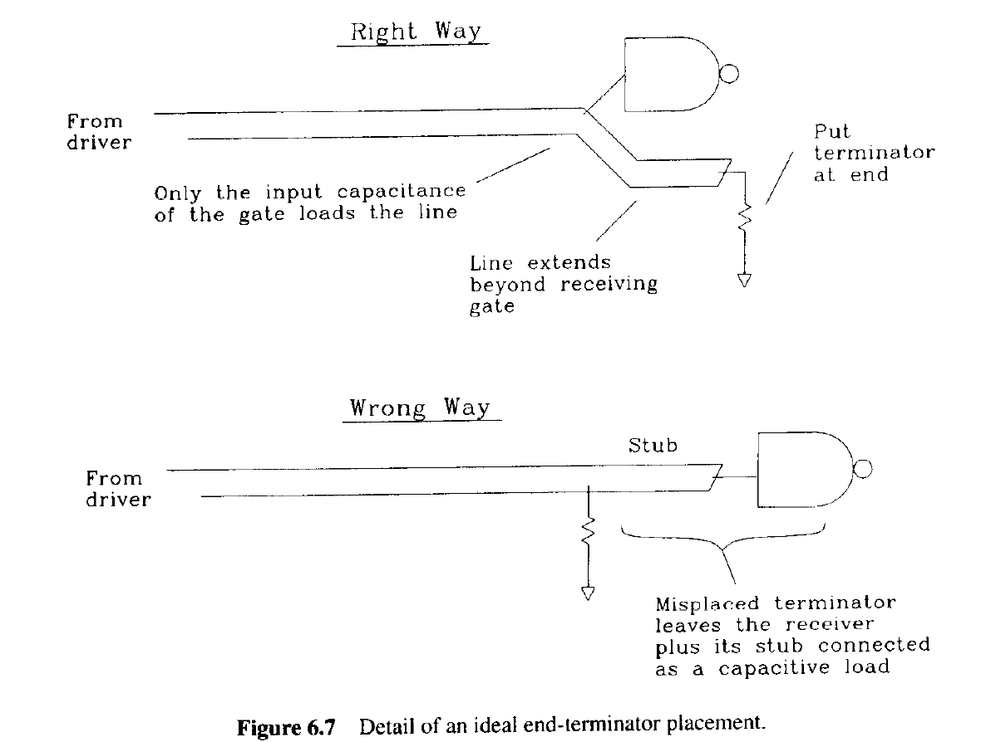
Termination Design
Terminator Resistor should be placed near the output pin!

Slide 10
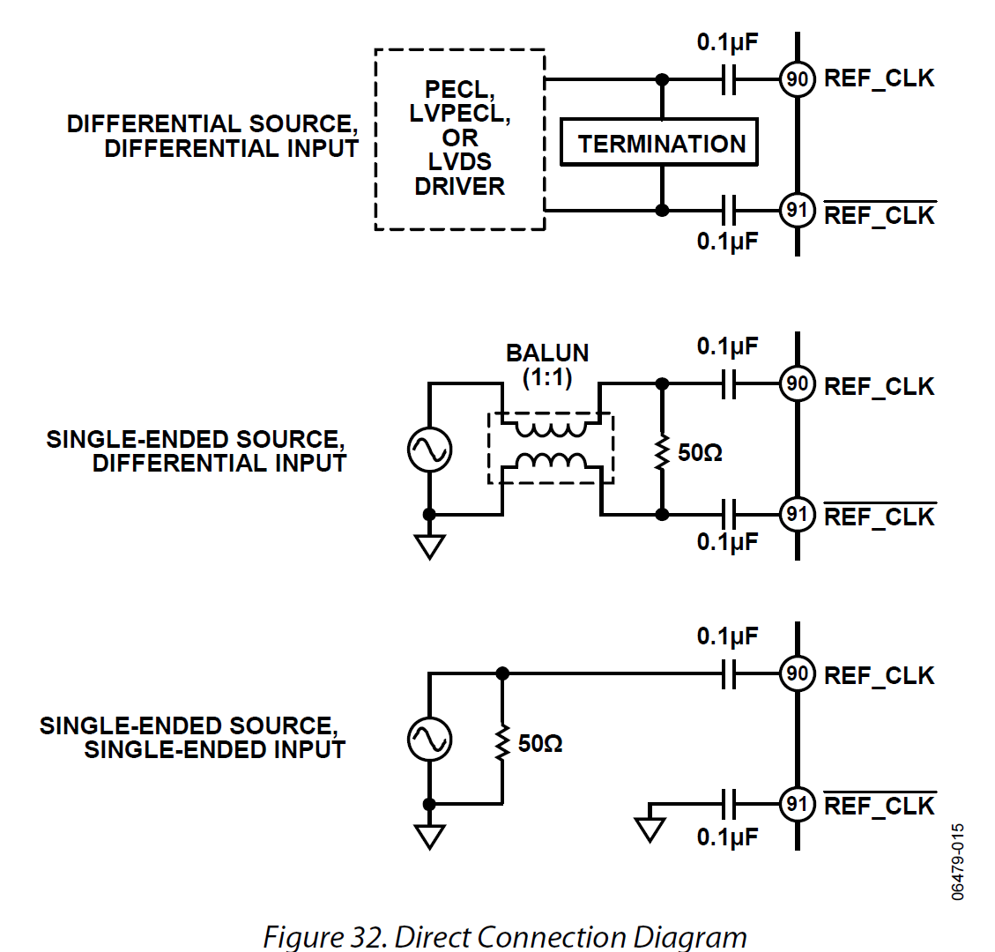
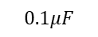
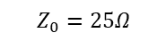
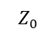
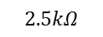
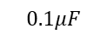
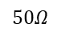
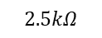
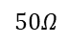
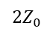
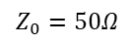
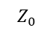
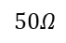
Clock Circuit Problem
Clock source
PCB trace
AD9910 input
$$Z_{0}$$
$$0.1μF$$
$$Z_{0}$$
$${2Z}_{0}$$
$$2.5kΩ$$
$$Z_{0}$$
$$0.1μF$$
$$Z_{0}=25Ω$$
$$0.1μF$$
$$50Ω$$
$$50Ω$$
$$2.5kΩ$$
$$Z_{0}=50Ω$$
$$0.1μF$$
$$0.1μF$$
$$50Ω$$
$$50Ω$$
$$2.5kΩ$$
$$0.1μF$$

Slide 11
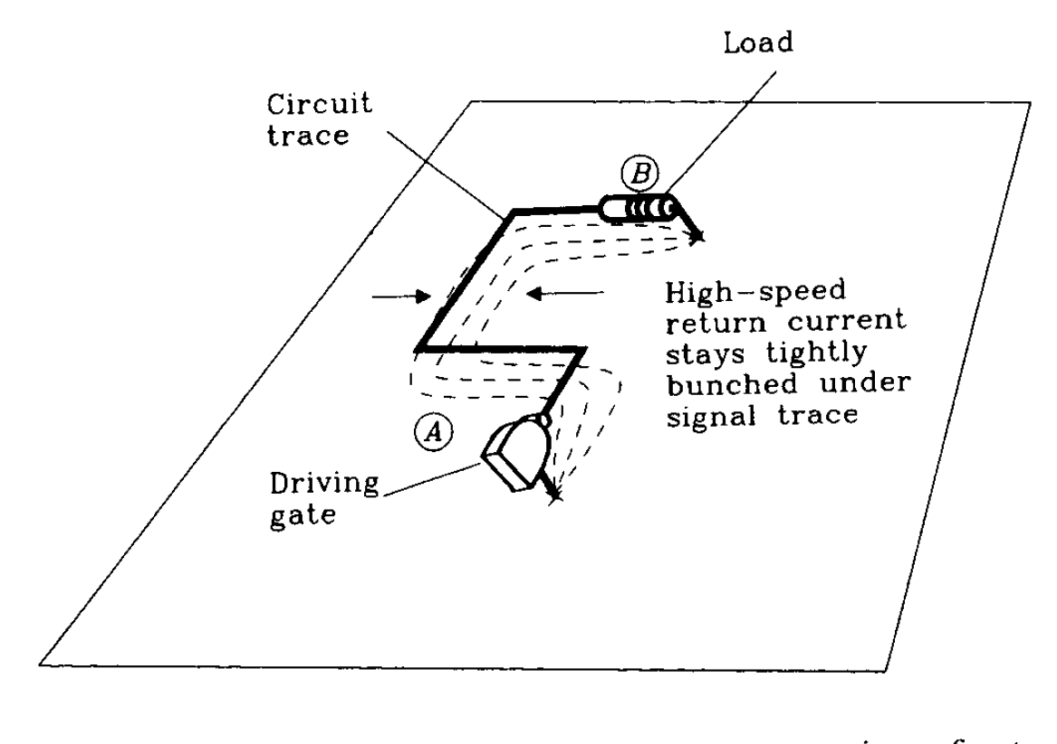
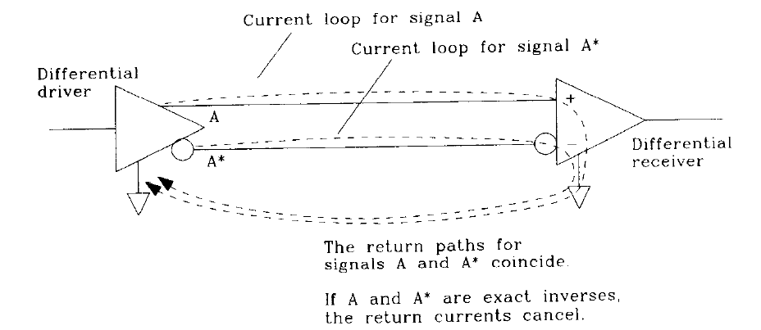
Return Path

Slide 12
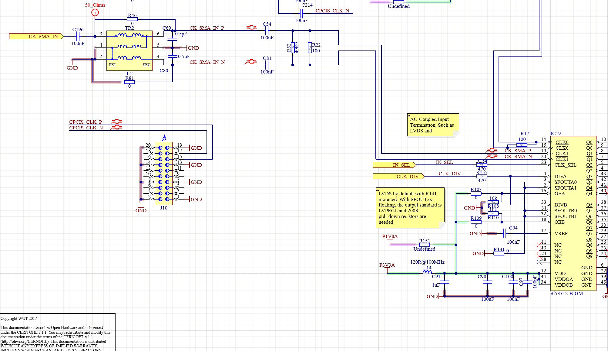
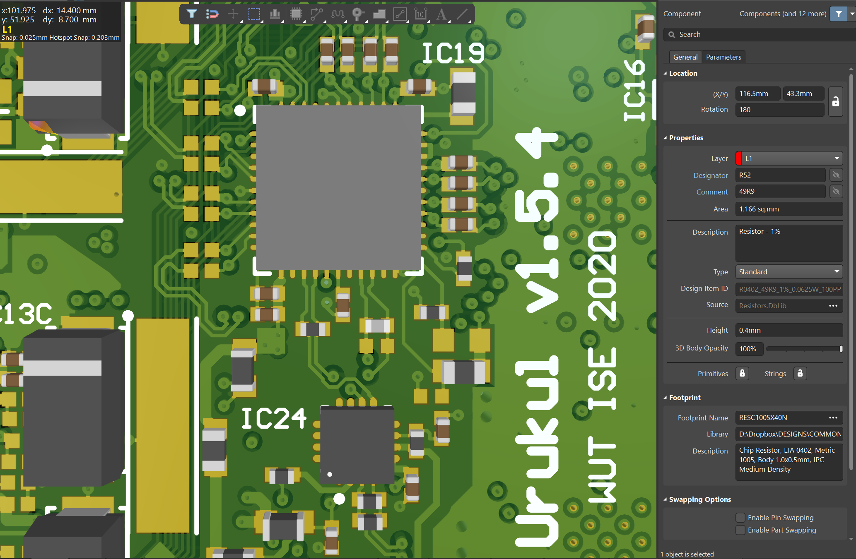
Urukul Termination Design
Termination Resistor is placed near the output pin

Slide 13
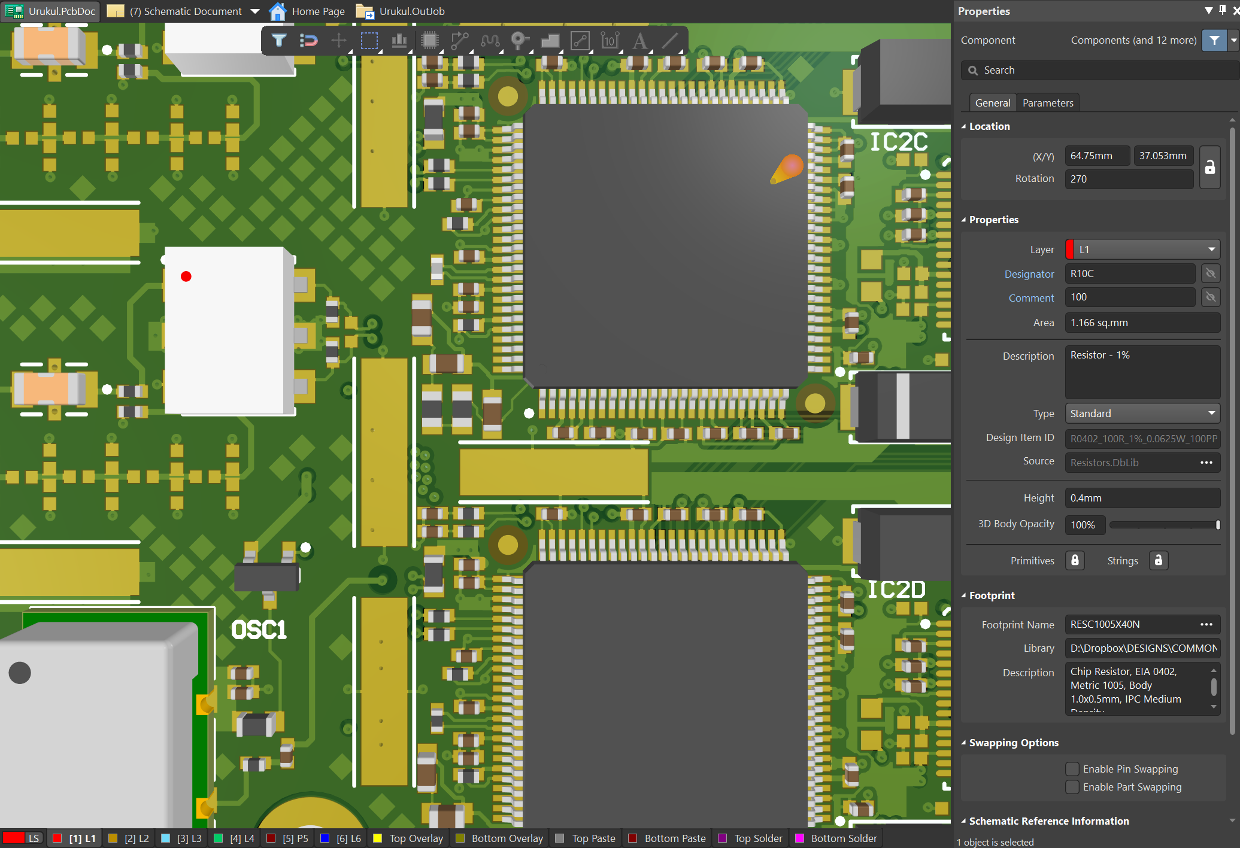
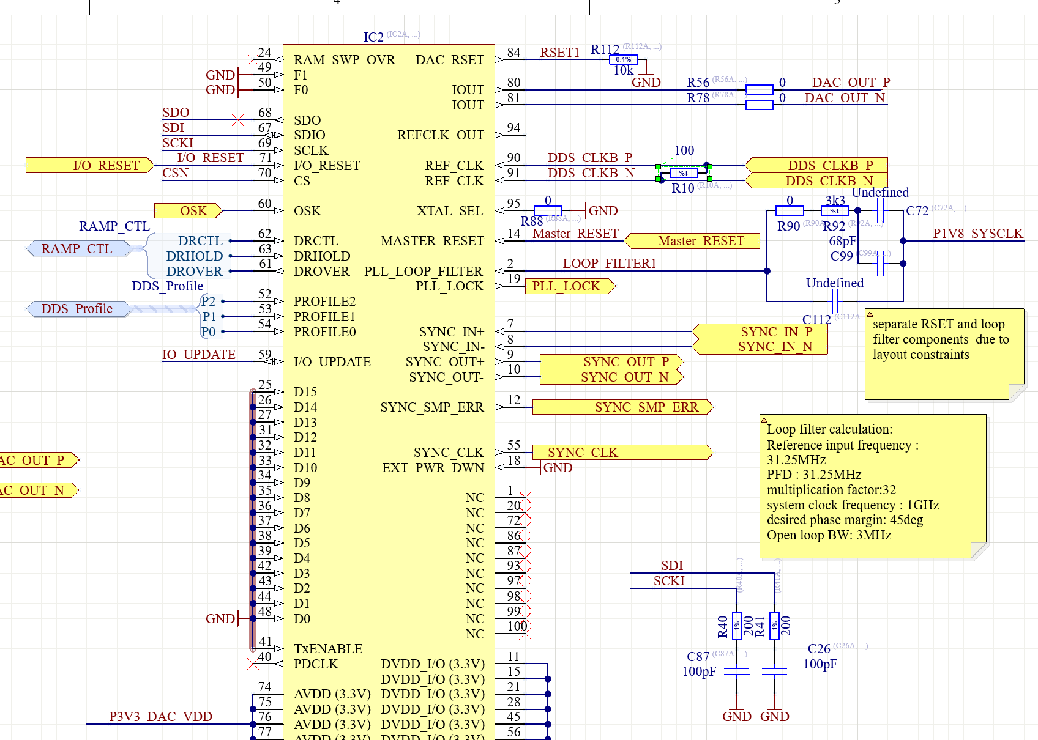
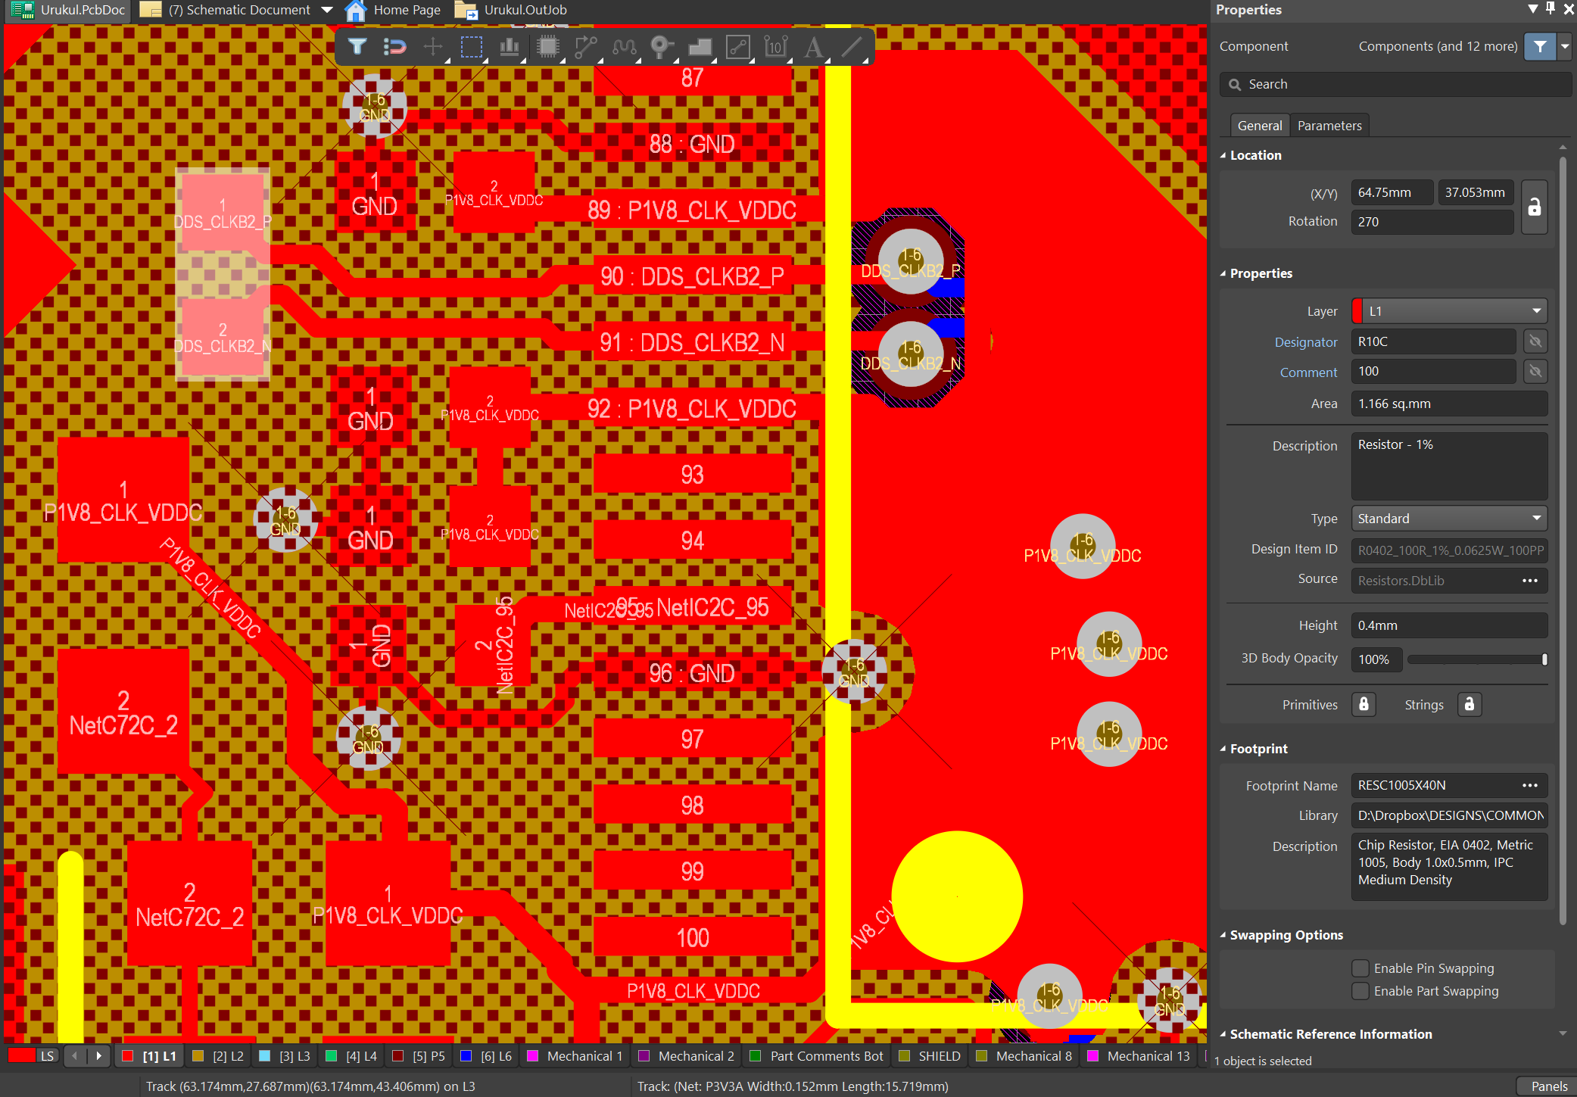
Urukul Termination Design
Termination Resistor is placed near the output pin

Slide 14
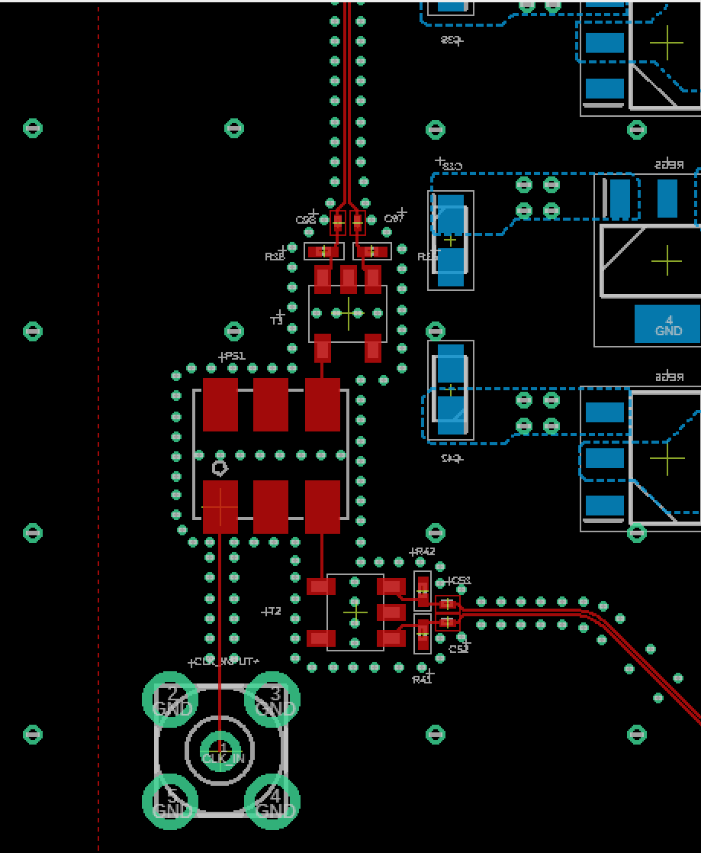
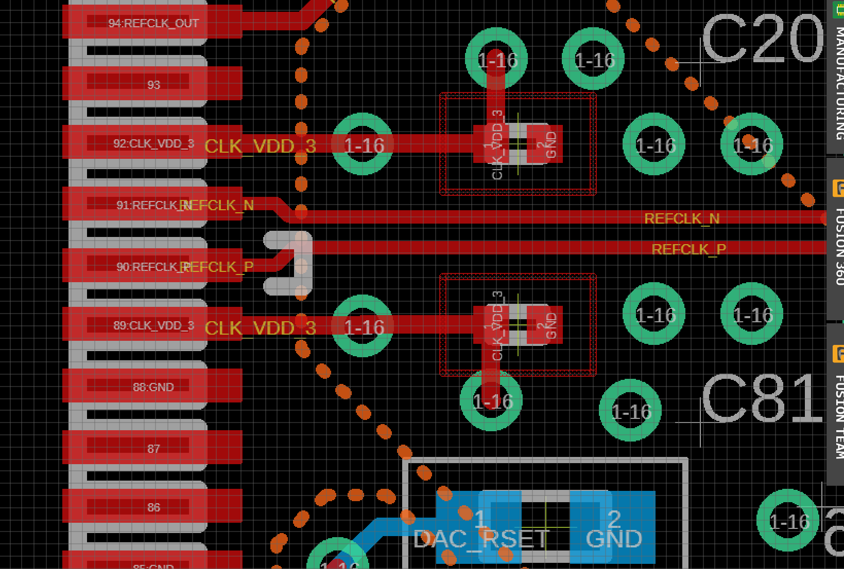
In our AD9910 design
Termination resistor is placed near the input pin->does not work
No termination resistance in output pin
-> high reflection!

Slide 15
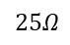

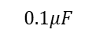
Design Improvement
$$0.1μF$$
$$Z_{0}=25Ω$$
$$50Ω$$
$$25Ω$$
$$2.5kΩ$$
$$25Ω$$
$$0.1μF$$
$$Z_{0}=25Ω$$
$$50Ω$$
$$50Ω$$
$$2.5kΩ$$
$$0.1μF$$
$$0.1μF$$

Slide 16
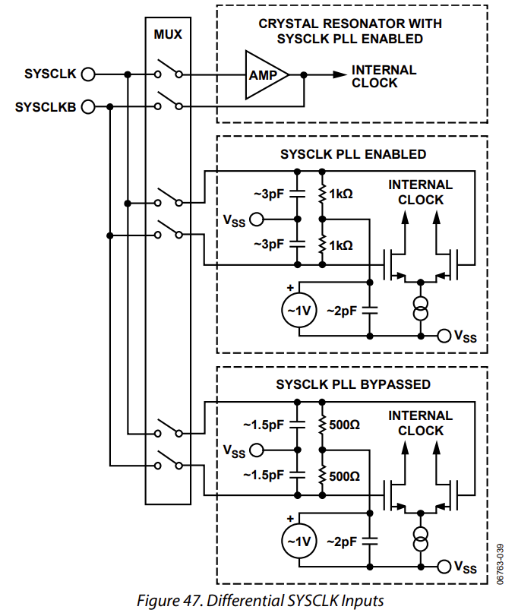
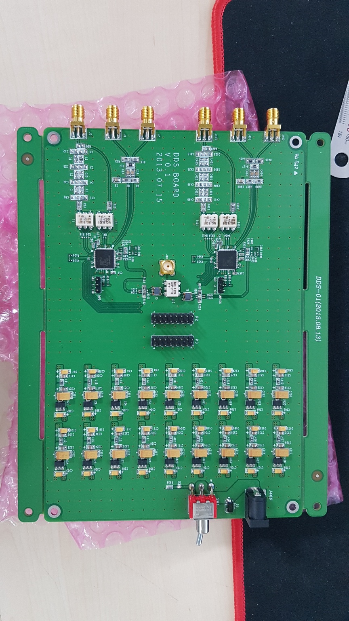
In our AD9912 design
PCB trace is not that long(3~5cm) -> RF effect is more lower than case of AD9910
Input resistance difference is lower than case of AD9910
->Reflection is much lower than case of AD9910

Slide 17
Validation of Clock Trace Problem
AD9910 board
NA9917A
CLK
PORT
Measure return loss(input power - return power) with CAT(Cable and Antenna Test) mode & power on
-> If no reflection : 10 ~ 13dB
Reflection : 0dB

Slide 18
Trace Position Problem

Slide 19
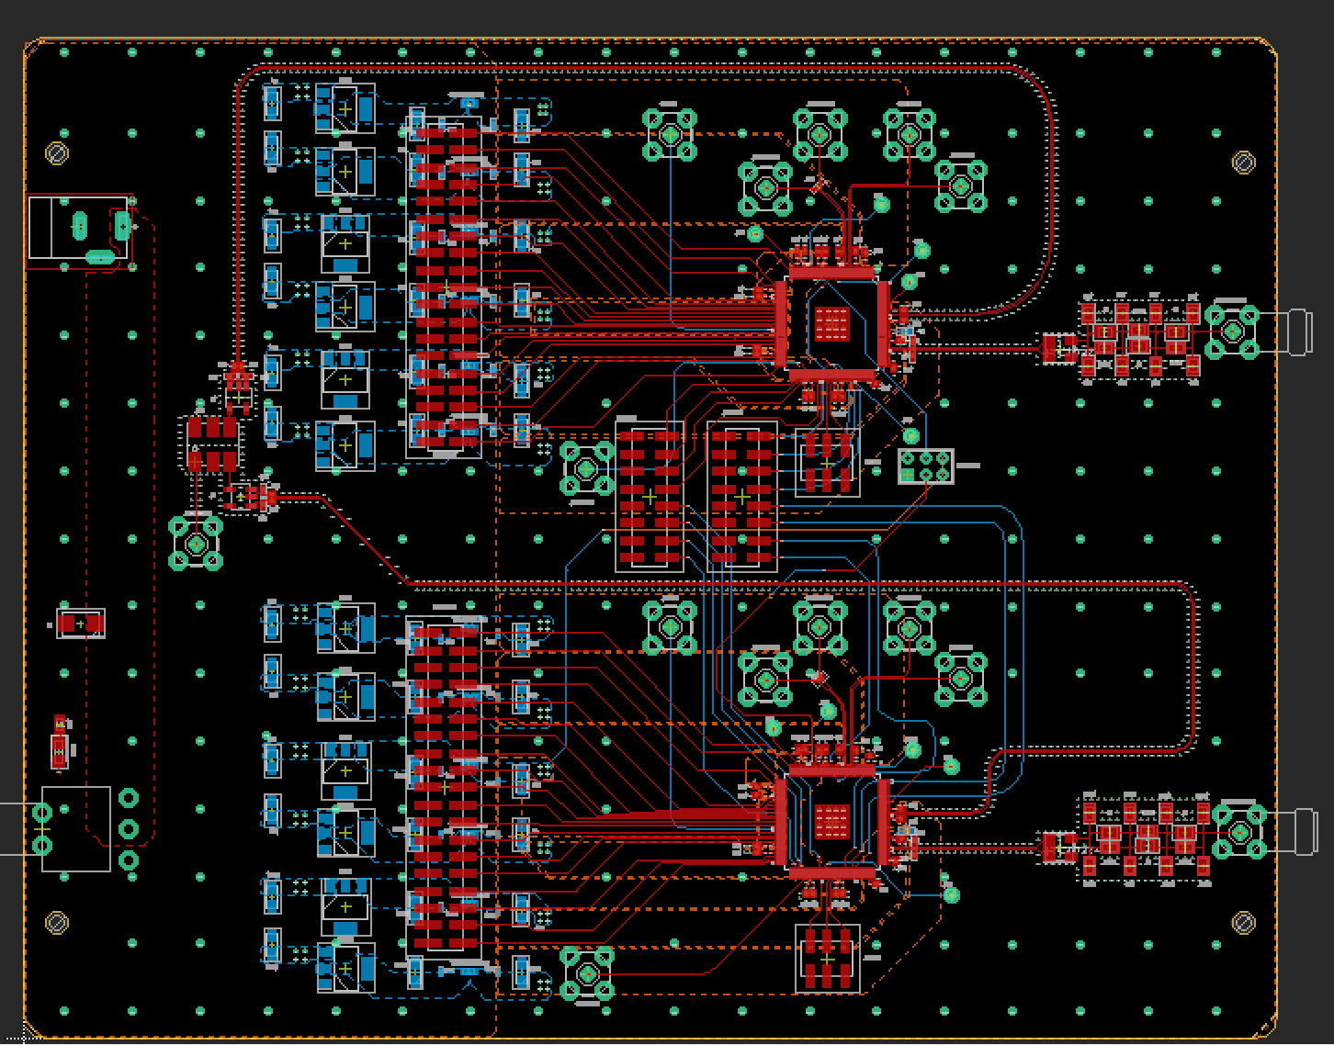
AD9910 board
1. Clock trace and output trace is too close
2. Clock trace is too long -> high inductance
-> high interference

Slide 20
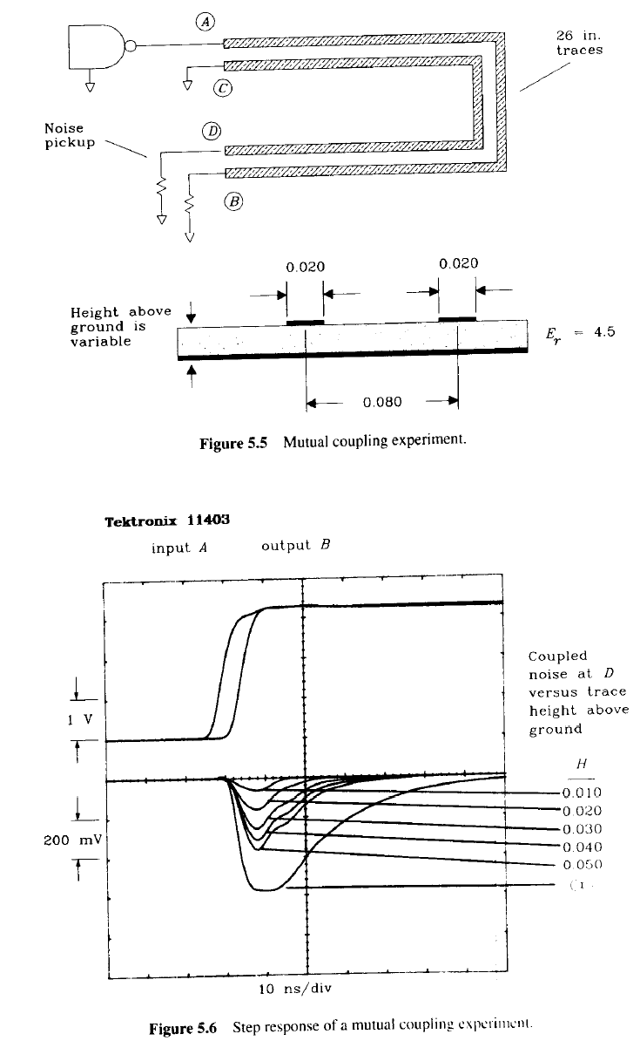
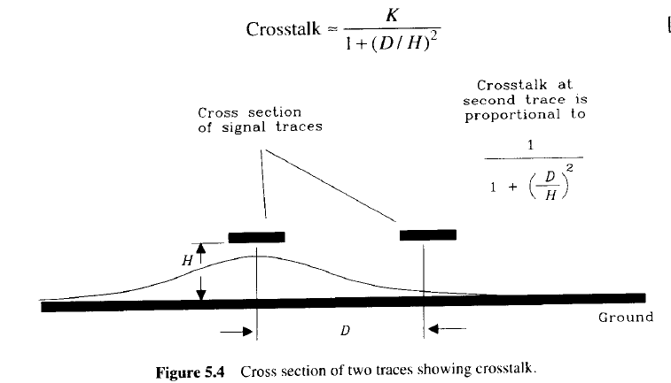
Crosstalk Problem

Slide 21
Design Improvement
Digital GND
Analog GND
AD9910
Balun
CLK_P
50
CLK_N
CLK_N
CLK_N
OUTPUT
Filter
IC
Digital Input
AD9910
Balun
CLK_P
50
CLK_N
CLK_N
CLK_N
OUTPUT
Filter
IC

Slide 22
Decoupling Capacitor

Slide 23
Decoupling Cap Position
CHIP
CHIP
V
Decoupling capacitor should be placed to near the pin of chip

Slide 24
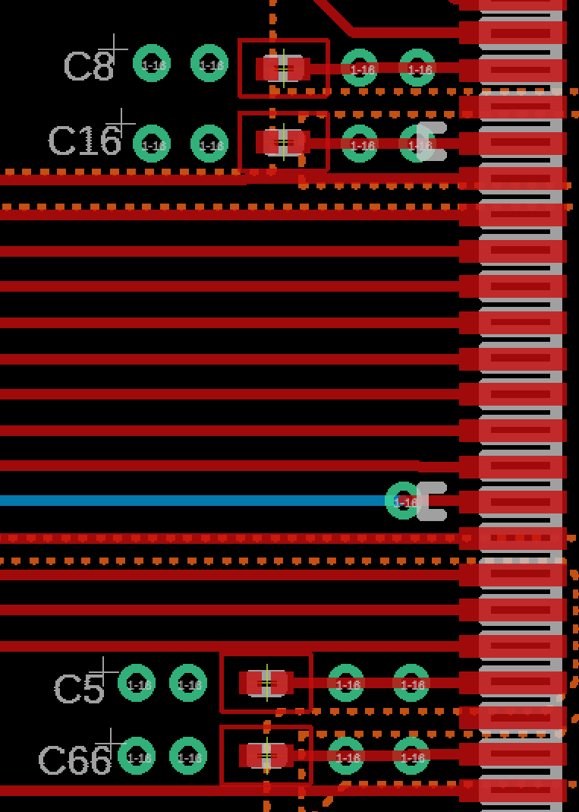
In Our Case
Decoupling capcacitor is too far from pin

Slide 25
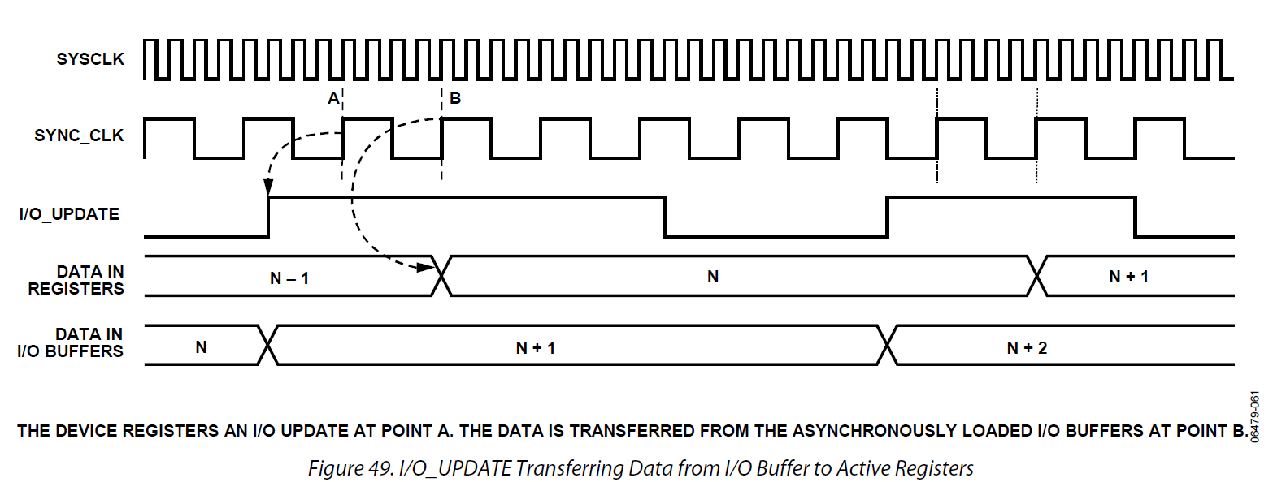
IO UPDATE timing diagram
Buffer Register
D flip flop
D Q
CLK
SPI_INPUT
IO_UPDATE
PROFILE
Edge Sensor
SYNC_CLK
see https://ez.analog.com/dds/f/q-a/28811/ad9914-and-io_update for more information

Slide 26
Parallel Data
VCC | GND | ja_3 SCLK | ja_2 IOUP2 | ja_1 SDIO2 | ja_0 CSB2
VCC | GND | ja_7 IOUP1 | ja_6 SDIO1 | ja_5 CSB1 | ja_4 PO[18]
GND | PO[15] jc_7
GND | PO[14] jc_6
GND | PO[13] jc_5
GND | PO[12] jc_4
GND | PO[11] jc_3
GND | PO[10] jc_2
GND | PO[9] jc_1
GND | PO[8] jc_0
GND | PO[7] jd_7
GND | PO[6] jd_6
GND | PO[5] jd_5
GND | PO[4] jd_4
GND | PO[18] ja_4
GND | PO[3] jd_3
GND | PO[2] jd_2
GND | PO[1] jd_1
GND | PO[0] jd_0
GND | PO[17] jb_1
GND | PO[16] jb_0
VCC | GND | jb_3 P2[1] | jb_2 P2[0] | jb_1 PO[17] | jb_0 PO[16]
VCC | GND | jb_7 P1[2] | jb_6 P1[1] | jb_5 P1[0] | jb_4 P2[2]
VCC | GND | jc_3 PO[11] | jc_2 PO[10] | jc_1 PO[9] | jc_0 PO[8]
VCC | GND | jc_7 PO[15] | jc_6 PO[14] | jc_5 PO[13] | jc_4 PO[12]
VCC | GND | jd_3 PO[3] | jd_2 PO[2] | jd_1 PO[1] | jd_0 PO[0]
VCC | GND | jd_7 PO[7] | jd_6 PO[6] | jd_5 PO[5] | jd_4 PO[4]

Slide 27
Profile change laency measurement
Is it deterministic?
How long is it?

